Slide 1


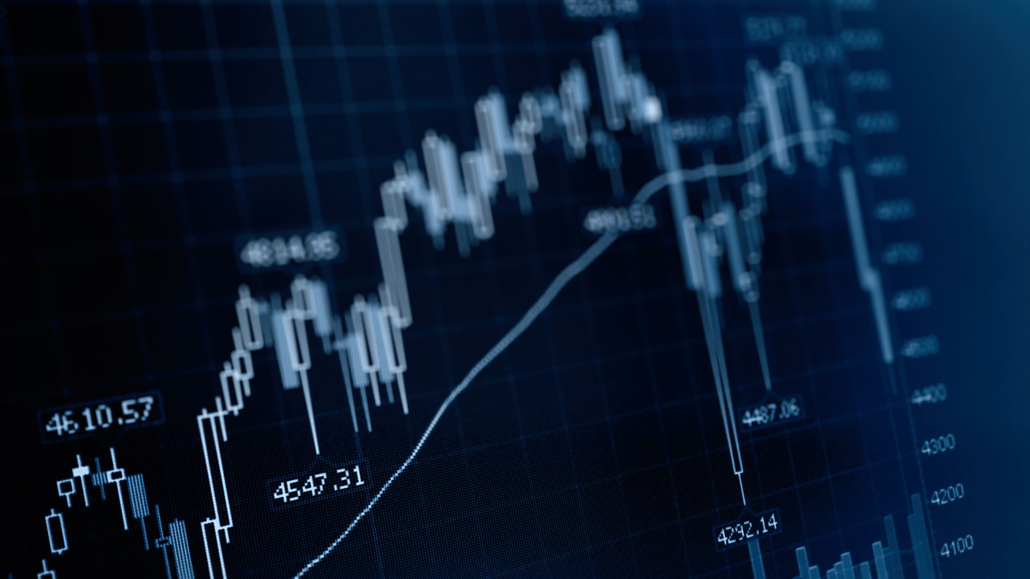
BlackRock Investment Analysis
Weekly Development Progress Status Report
Submitted By: Group 7
Aryan Radadiya
Joyson Domnic Gonsalves
Sumit Kumar Pandey

Slide 2






Table of Content
Description
Status
Communication
Budget
Challenges and
Proposed Solutions

Slide 3



Team Members
Aryan Radadiya
Developer
Joyson Gonsalves
Team Lead
Sumit Kumar Pandey
Data Analyst

Slide 4
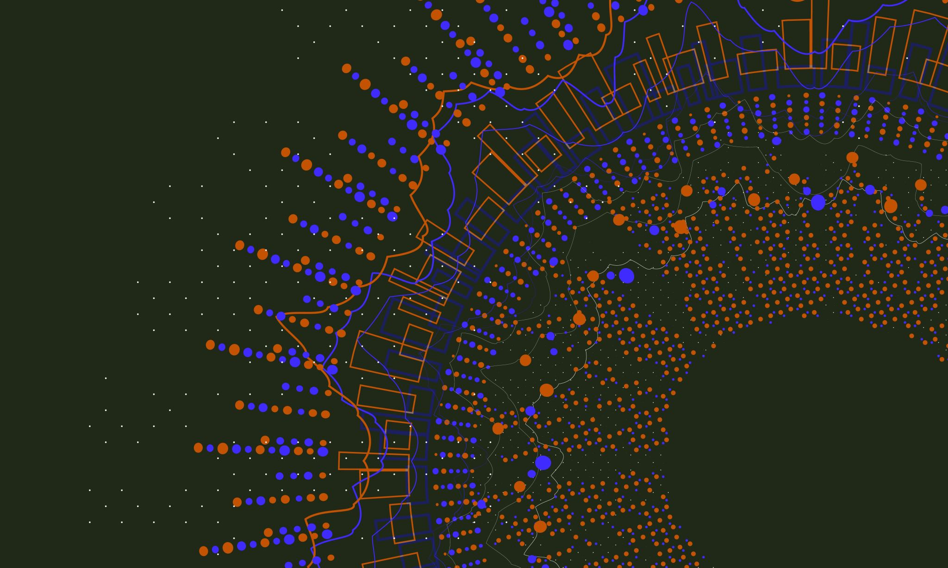
About BlackRock
Imagine BlackRock as a giant in the financial world, making big moves and decisions that impact how money flows globally. Our client, who's also a player in the financial game, wants to take a closer look at BlackRock's playbook. They're like the coach studying the strategies of a champion team. The goal? To understand exactly how BlackRock's decisions shake things up in the financial world right now. It's like looking at the game tape to see the moves that make BlackRock stand out. By doing this, our client hopes to get smart insights that can help them make better decisions in their own financial game.

Slide 5

About the project
The client aims to delve deep into BlackRock's data, seeking a comprehensive understanding of its present impact on the market. Their goal is not only to grasp the current dynamics but also to foresee the future, predicting how BlackRock's assets will evolve over time. It's essentially a quest for valuable insights that can guide strategic decision-making and prepare for the twists and turns of the financial landscape.

Slide 6
Date of Report: 19th March 2024
Date of Last Report: 12th March 2024
Prepared By: Group 7
Project Status: On Track

Slide 7

Timeline
Initial Requirement
Design
Implementation/ Coding
Development
Testing
Final Report
Today

Slide 8
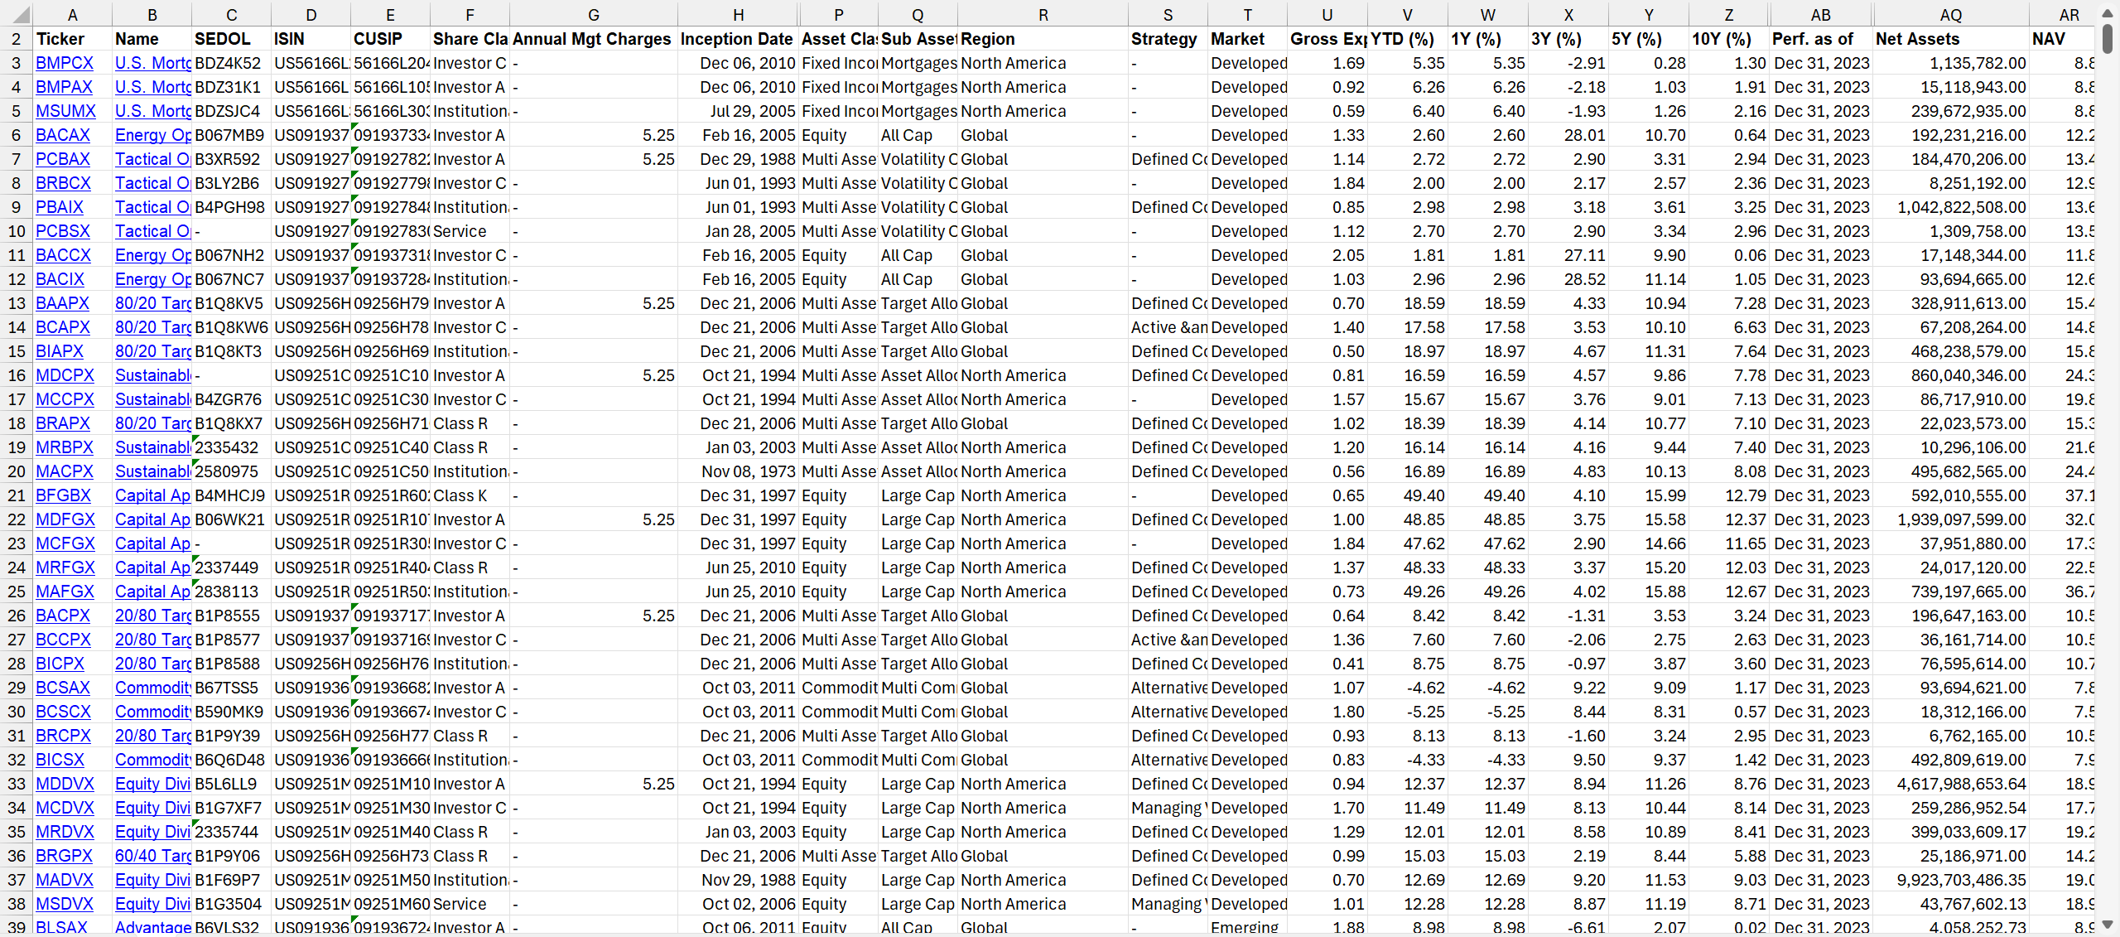
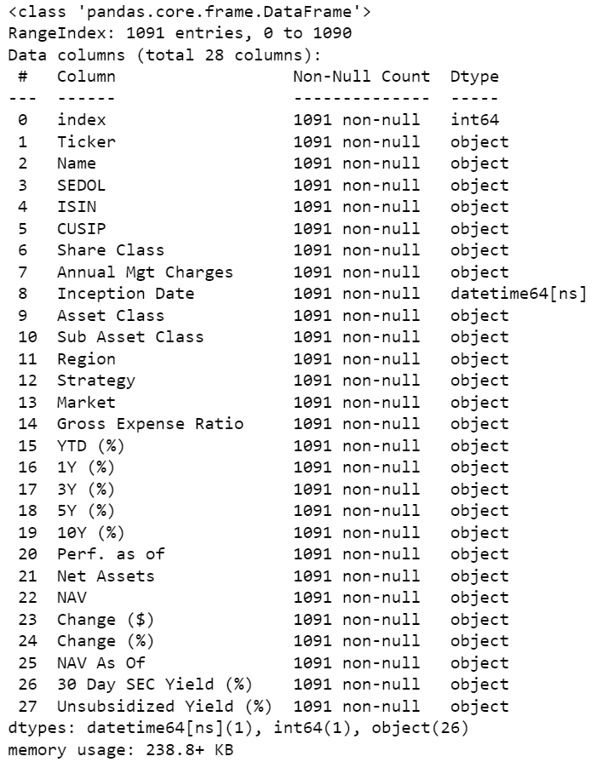
Initial Requirement
Source: BlackRock Investment Funds

Slide 9


Design Phase
Research Datasets
BlackRock has a very diverse portfolio so it is important to find right dataset which is perfect for our research.
Collecting Dataset
Initially scraping data directly from the official site is challenging so we downloaded the data to our local machine and then uploaded it to our Jupiter notebook.
Cleaning Dataset
There are many null values and unwanted data which we are not going to use so we will remove the columns and data which we don’t want.

Slide 10
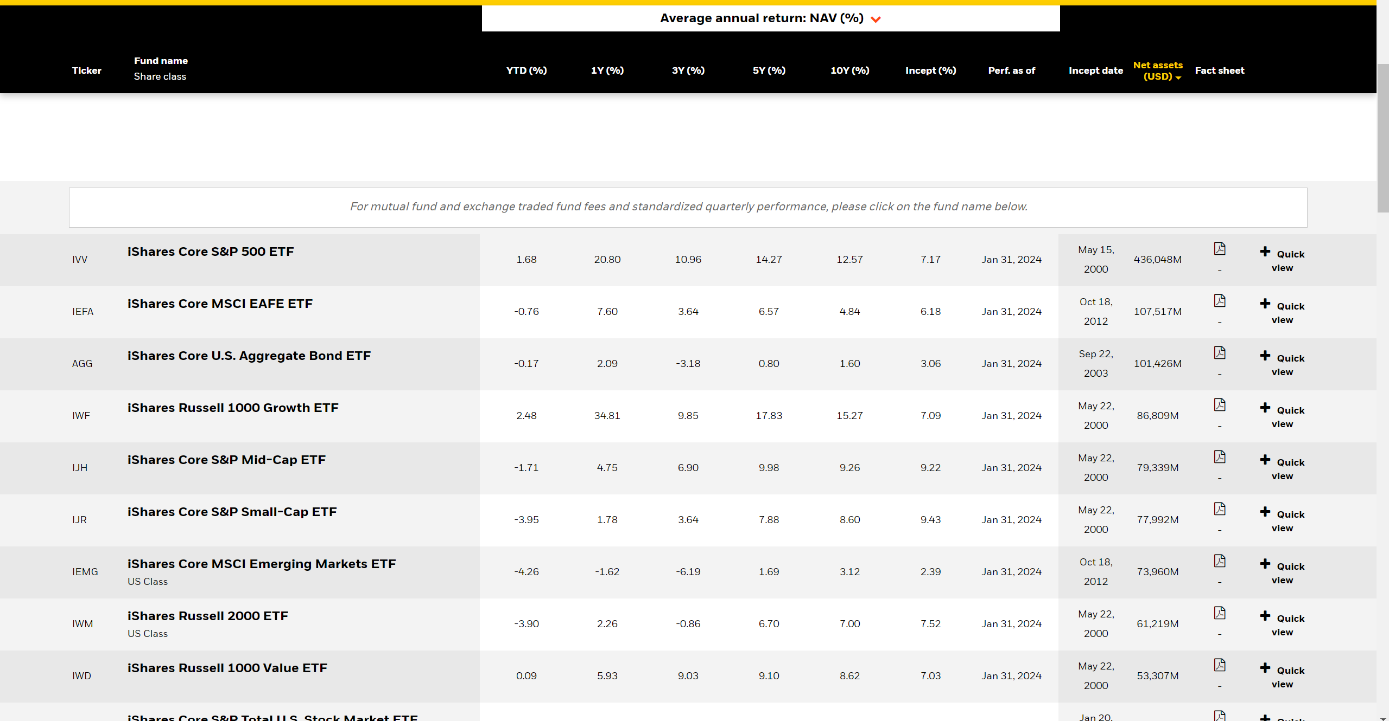
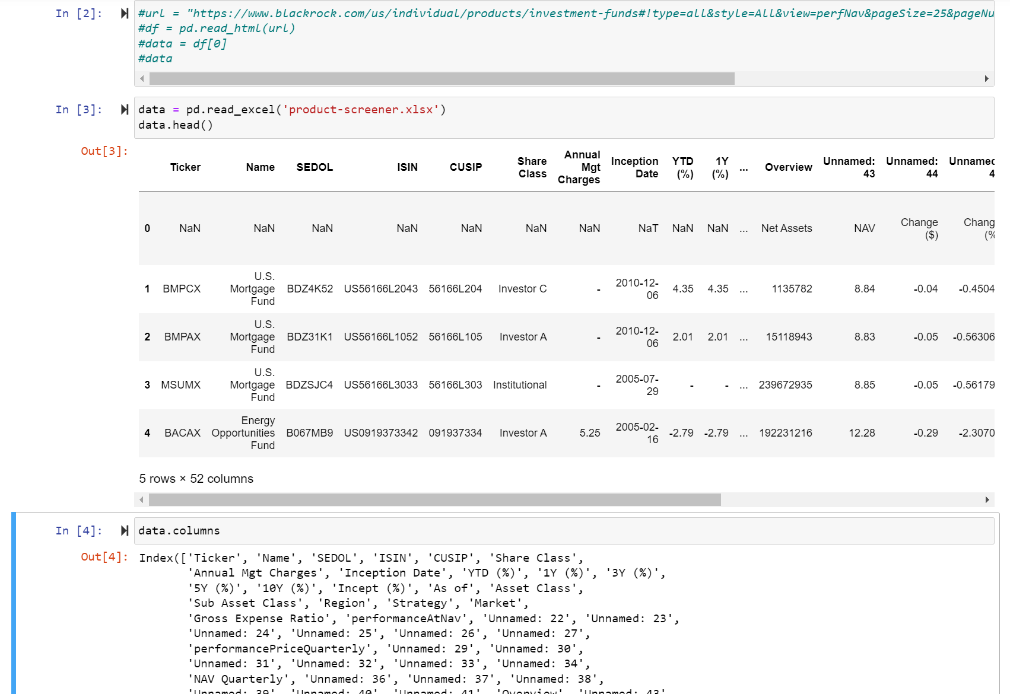
Data Collection
Importing in Jupiter Notebook
Official BlackRock Site

Slide 11
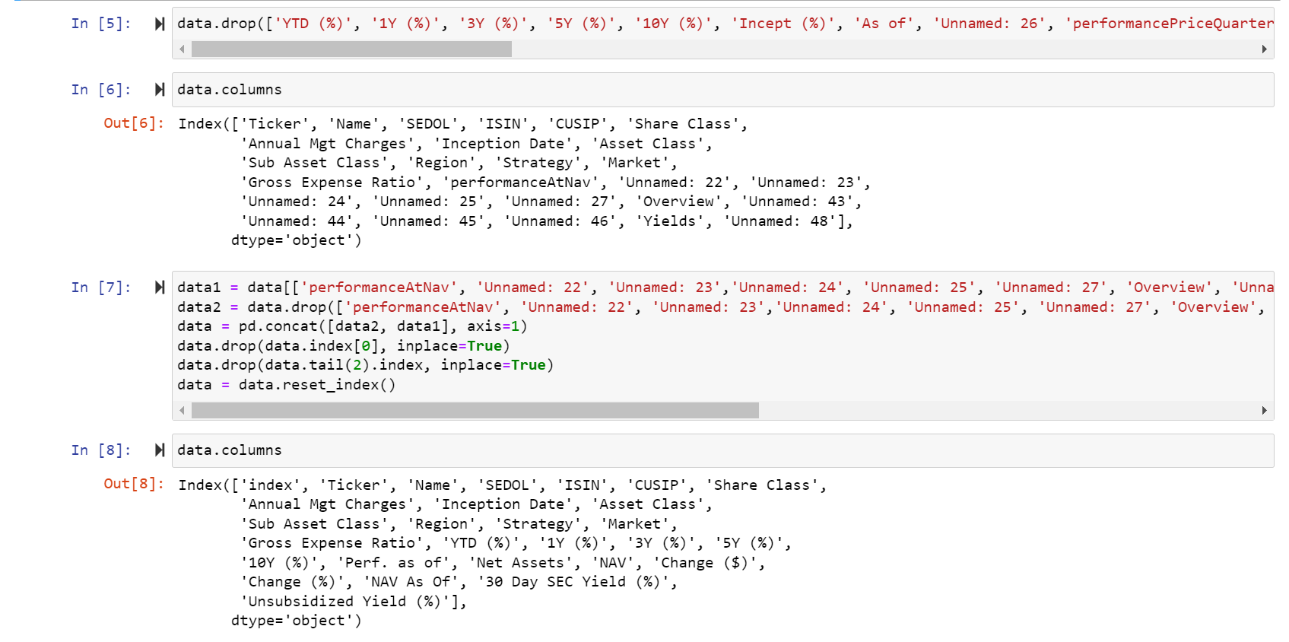
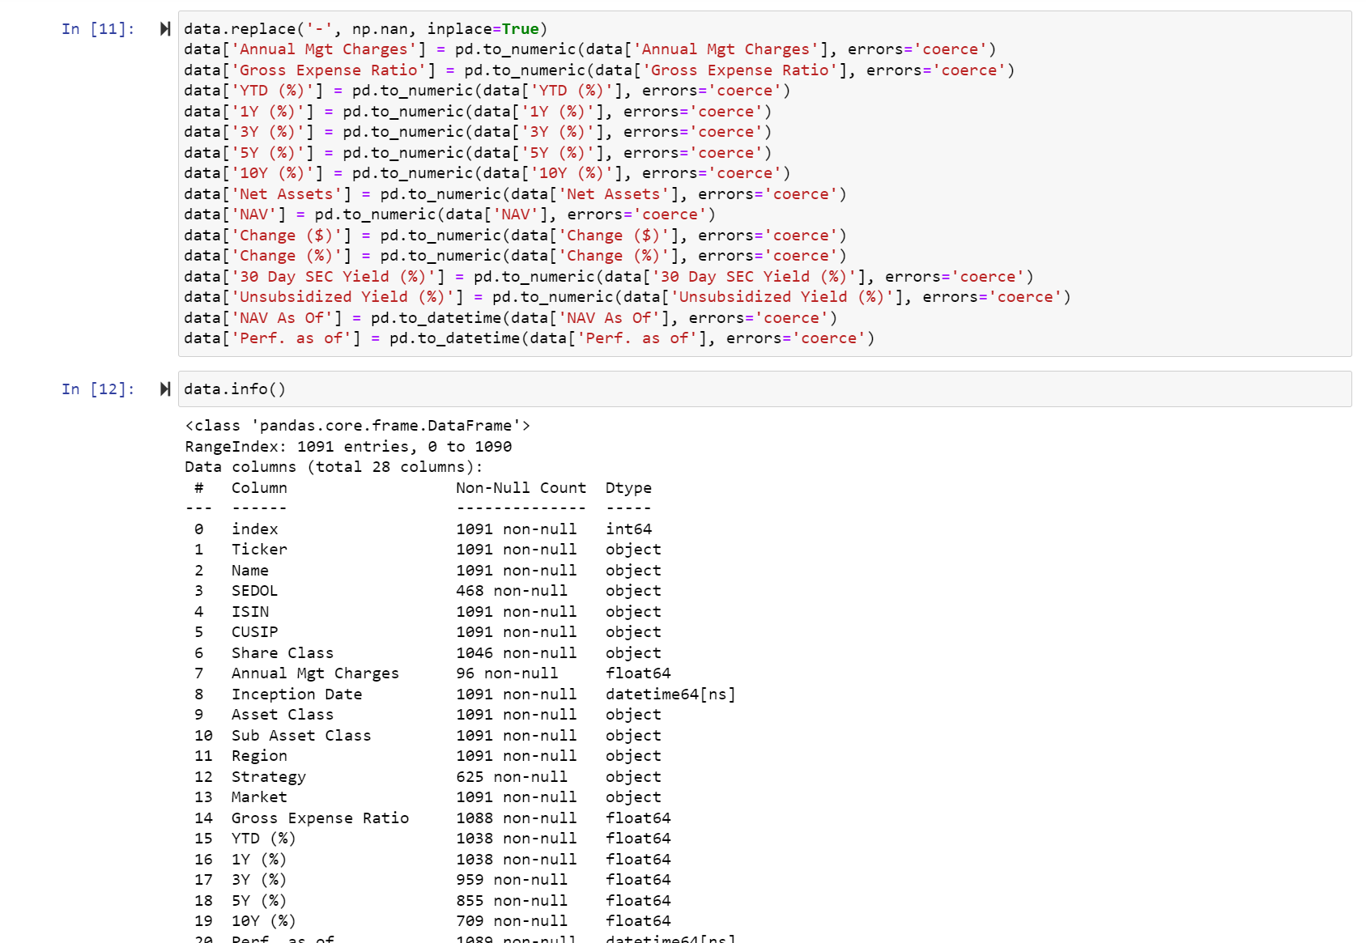
Data Cleaning
Changing data type of columns
Removing unwanted rows

Slide 12
Implementation / Coding
Planning the Analysis
We need to analyse the data and see which machine learning model we can apply and according to our expected outcome we need to proceed further.
Research the Analysis Model
Implement the Model
After learning about the model now we can start coding on the model and run the test cases to see if it works or not.
After completing the basic analysis we know that we can implement cluster analysis on our data. So we will research on that and gather more details.

Slide 13
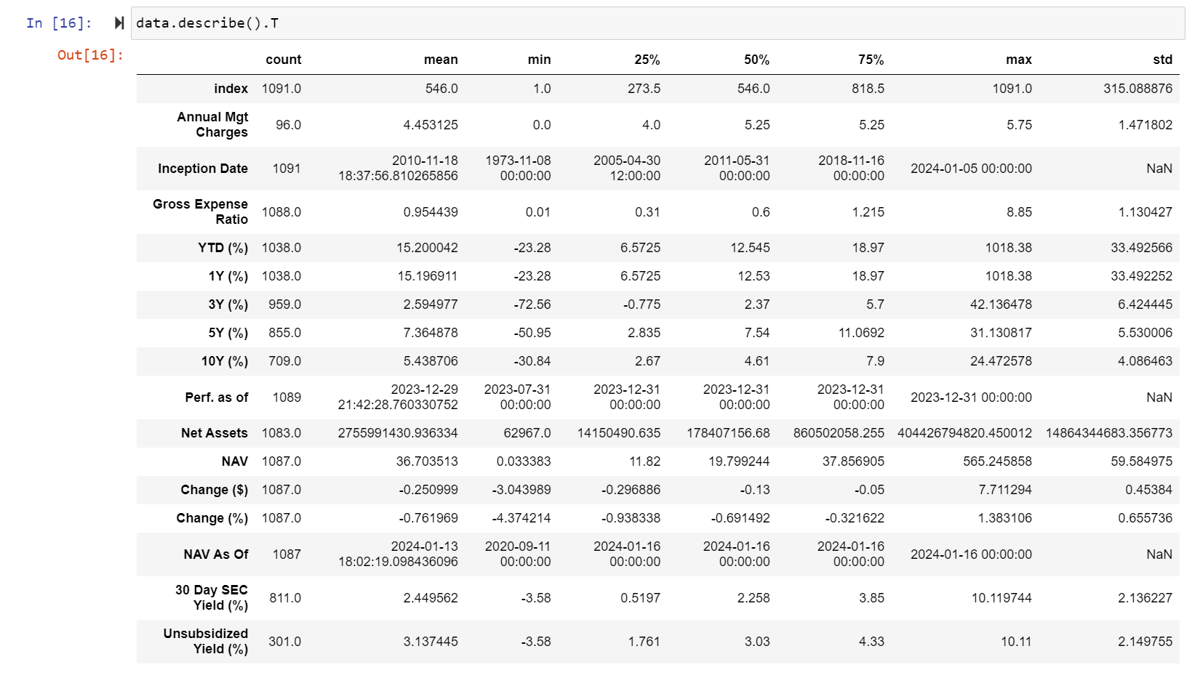
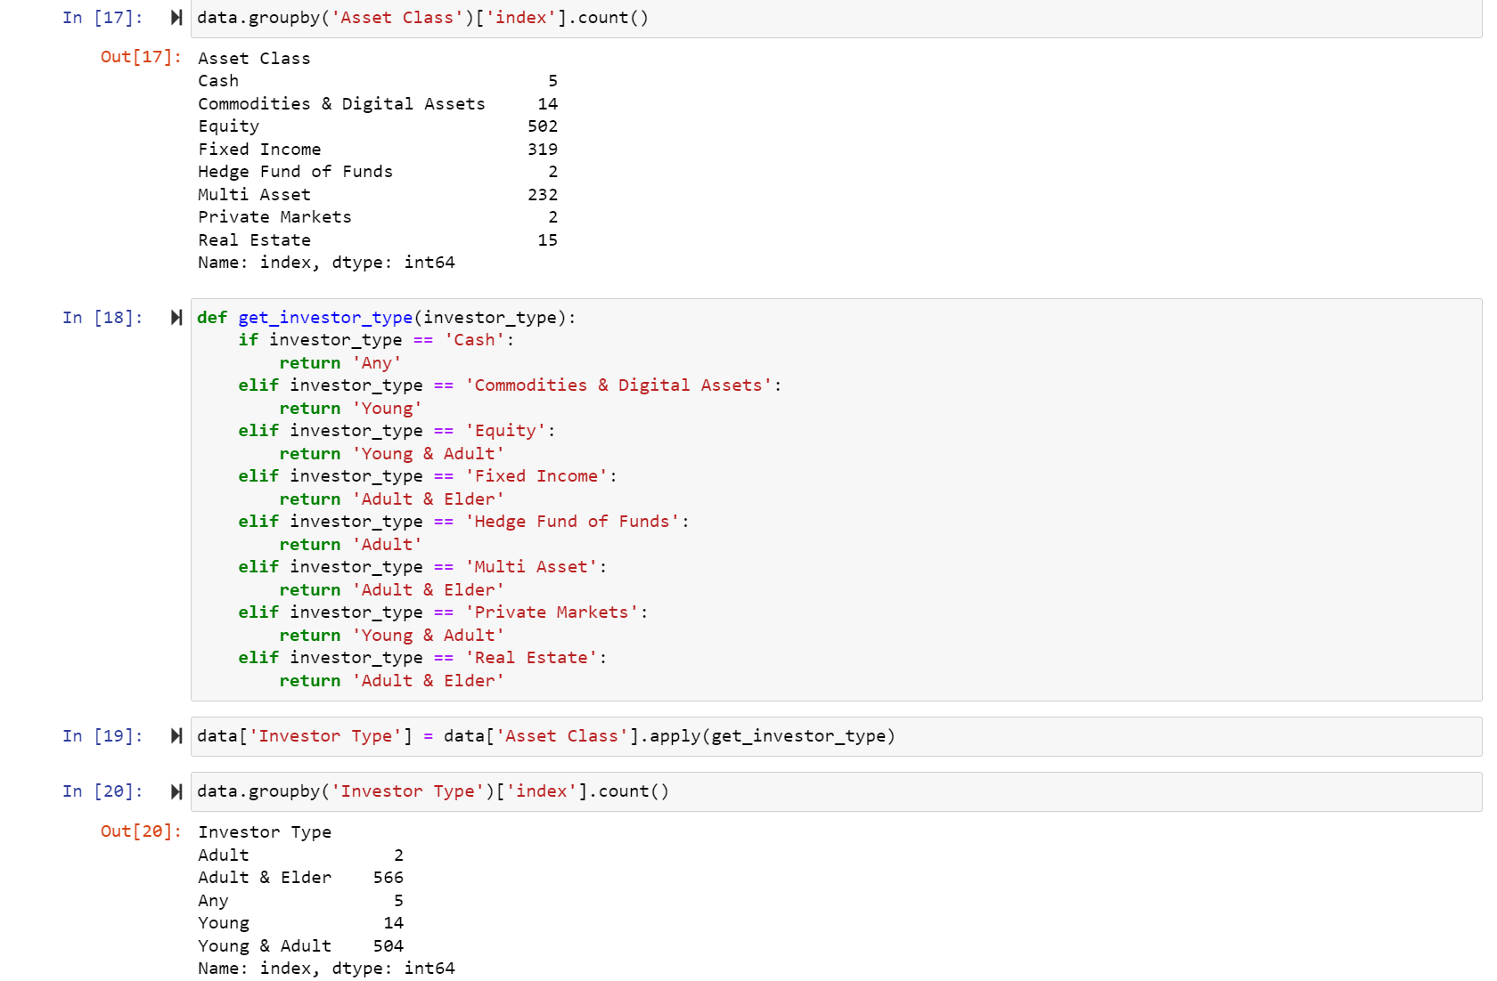
Performing the EDA Analysis
Grouping and categorising the data
Descriptive analysis on the numeric data

Slide 14
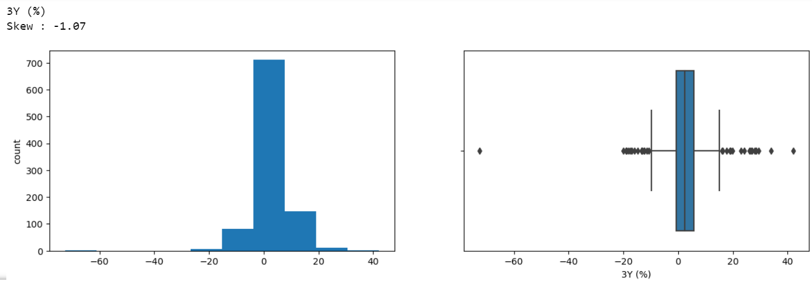
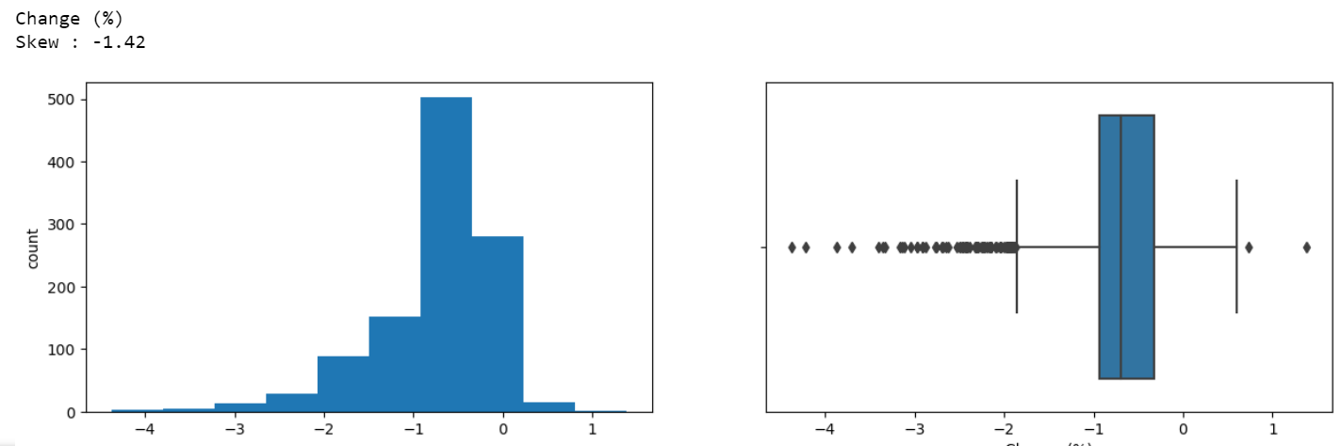
Visualizing Numeric columns

Slide 15
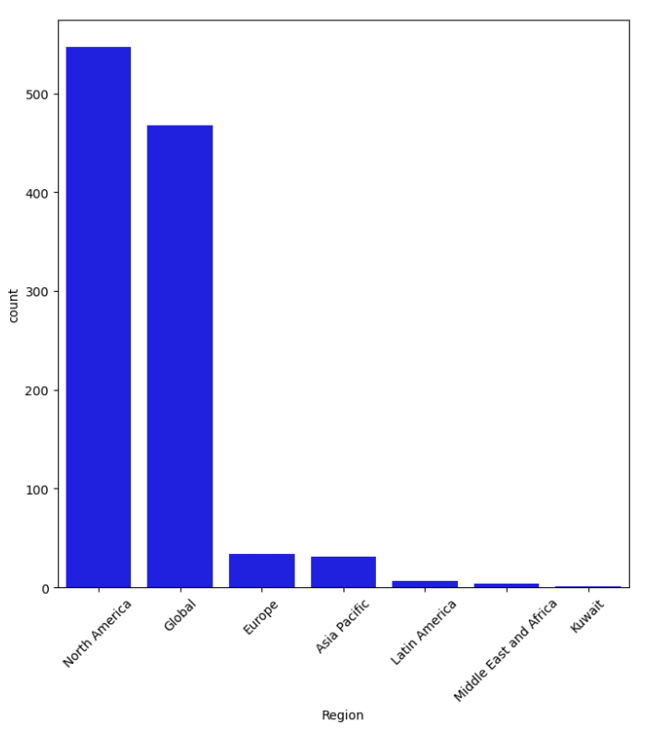
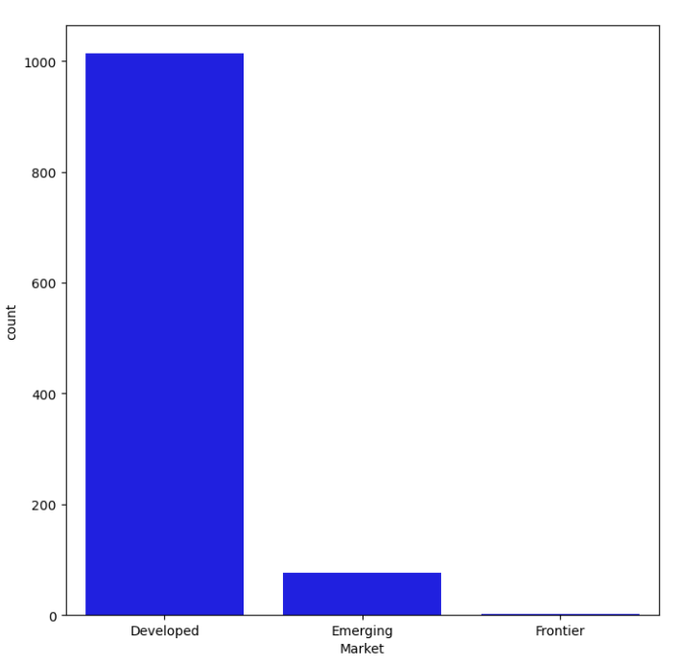
Visualizing Categorial Columns

Slide 16

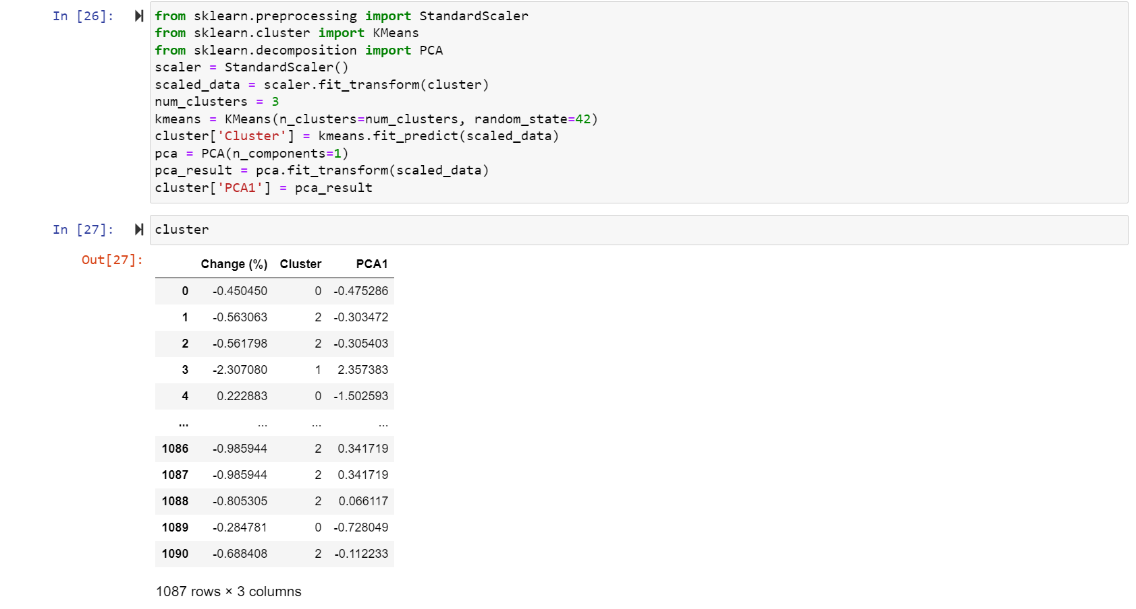
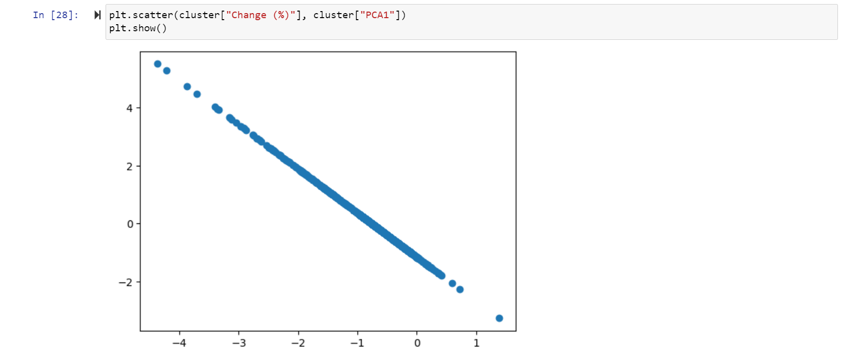
Cluster Algorithm

Slide 17
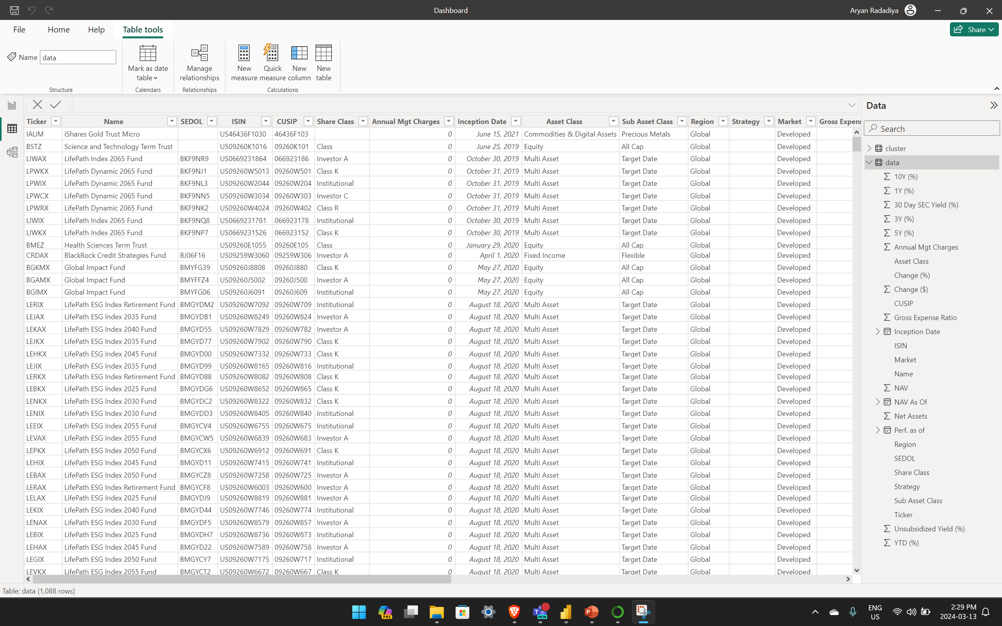
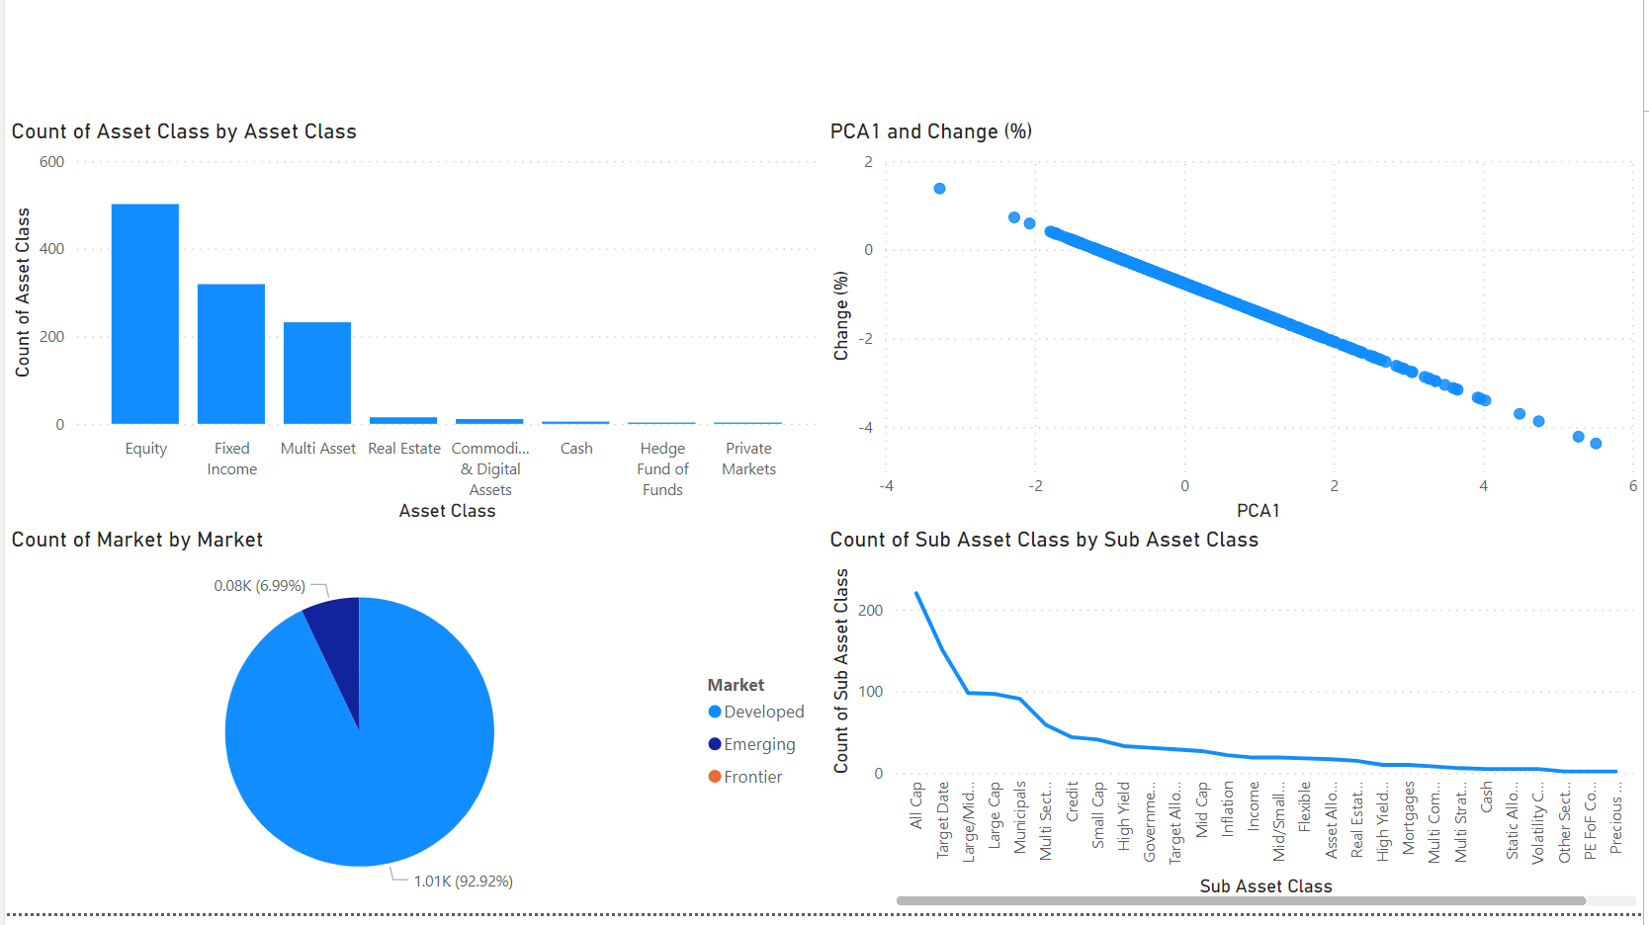
Power BI Visualization and Story

Slide 18

Communication

Slide 19
Frequency
Once a Week
Participants
Richard Lambroff
Medium
Review the progress
Agend
Aryan Radadiya
Joyson Domnic Gonsalves
Sumit Kumar Pandey
Recording
Teams Meeting
Call
Chats
Weekly Development Status Report

Slide 20

Challenges
We face issue implementing certain Machine learning Algorithms.
Designing multipage visualization to show demonstrate proper story.

Slide 21
Proposed Solution
We tested different ML algorithms and see which suits best for our data.
We design multiple prototypes for our dashboard.

Slide 22
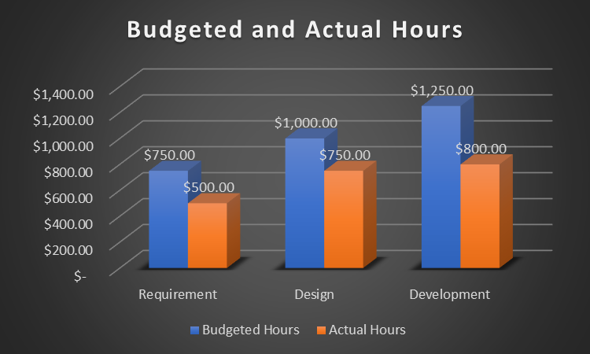
Project Cost

Slide 23

Final Phase
We have started designing the visualization pages and dashboard.
We also have started planning the final presentation and how our story will play.

Slide 24
Video Explaination
https://youtu.be/RrVnDT2DowM

Slide 25

Thank You Any Questions?

